Slide 1
Industrial Equipment Inspection System
Tapaswi Satyapanthi
Kush Parmar
Siddharth Bahekar
Rachita Shah

Slide 2
Problem Statement
The objective of our application is to provide a streamlined and efficient solution for tracking inspections within industrial plants. By centralizing inspection data and facilitating seamless communication between inspectors, evaluators, and plant managers, our application aims to enhance safety, compliance, and operational efficiency within industrial facilities.

Slide 3
Purpose
Improve Safety: Enhance safety standards within industrial plants by ensuring regular and thorough inspections of equipment
Ensure Compliance: Ensure regulatory compliance by enabling inspectors to perform inspections according to industry standards and legal requirements
Enhance Accountability: By assigning specific roles and responsibilities to inspectors, evaluators, and plant managers, our application promotes accountability throughout the inspection process
Facilitate Communication: Serve as a centralized platform for communication and collaboration among stakeholders involved in the inspection process
Support Growth and Scalability: Accommodate growing needs

Slide 4
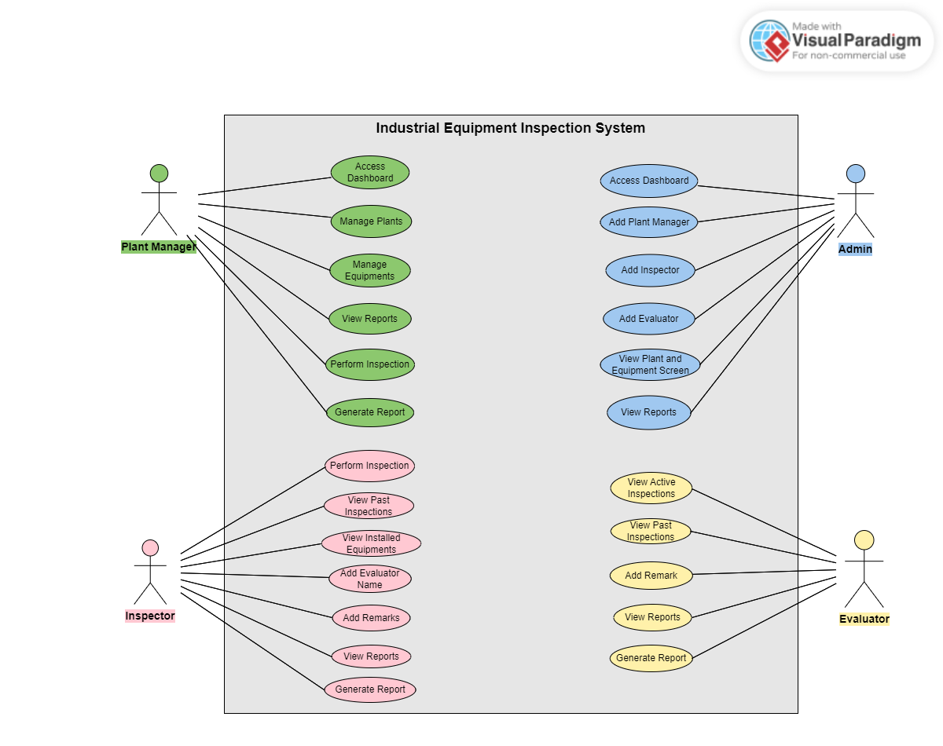
Use Case

Slide 5
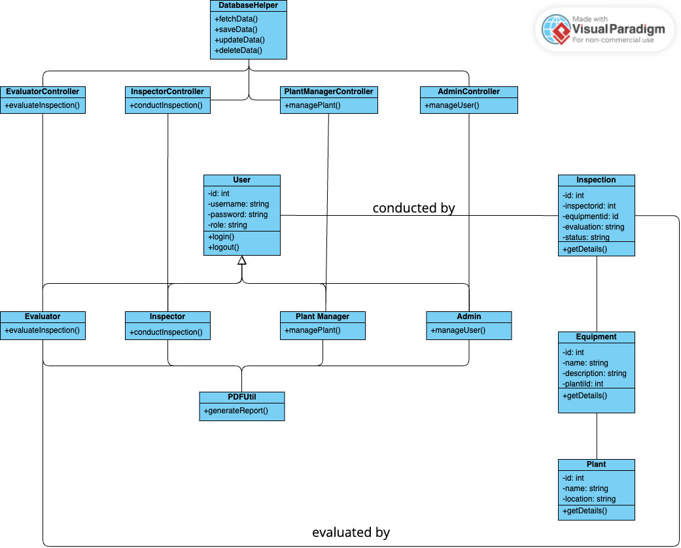
Class Diagram

Slide 6
Implementation Techniques
Java MVC Architecture
Singleton Design Pattern
MySQL Database
Python for Data Visualization
iText PDF for report generation

Slide 7
Enterprise Description
Key Players:
Industry: Admin, Plant Manager
Third-Party Audit: Inspector, Evaluator
Roles:
Admin: Coordination and communication
Plant Manager: Operational insights and readiness
Inspector: On-site inspections
Evaluator: Analysis and recommendations

